Slide 1

Clustering Neighborhoods in Toronto
Xiqiao Liu
IBM-Capstone

Slide 2
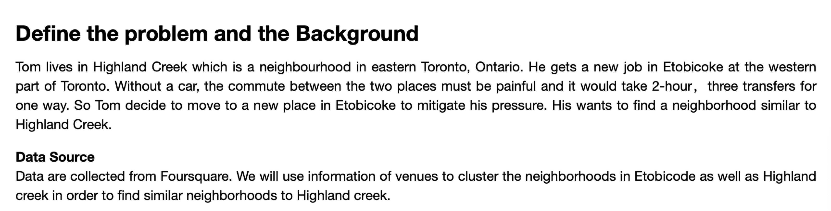
Problem

Slide 3
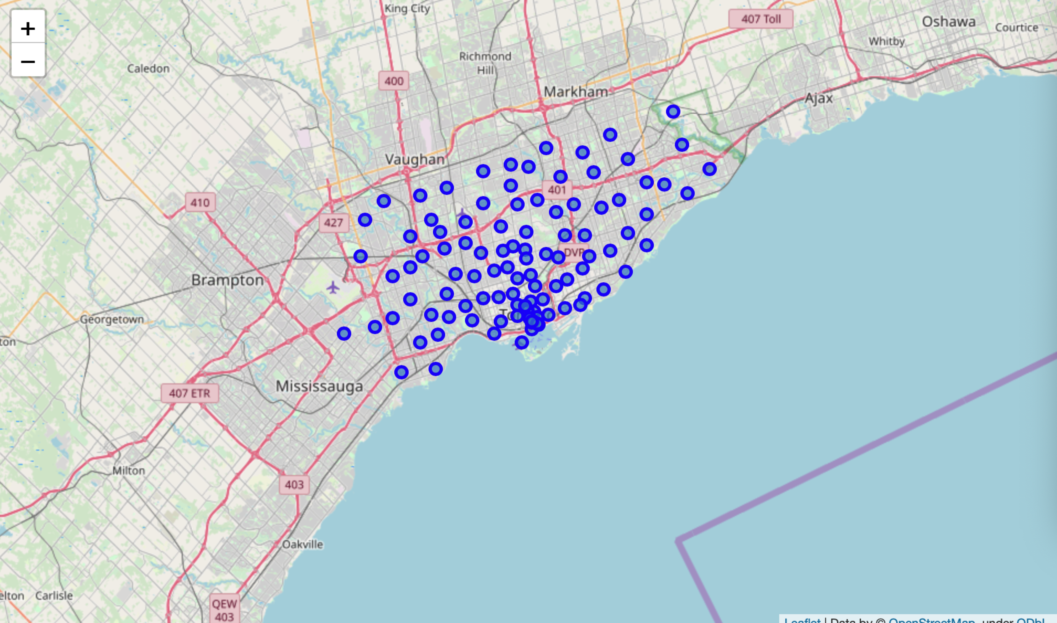
Neighborhoods in Toronto

Slide 4
Data Sources
The location coordinates of each borough are collected from Wikipedia. A table displays latitude and longitude of boroughs in Toronto.
Venues categories of each borough in Toronto are collected from Foursquare through Foursquare API.

Slide 5
Approach
To find similar neighborhoods, I clustered the neighborhoods based on the venue categories within each area.
K-modes model is applied here because the variables are categorical. K-means has better performance for numerical data, however, Euclidean Distance can’t appropriately find the dissimilarity of categorial data points.

Slide 6
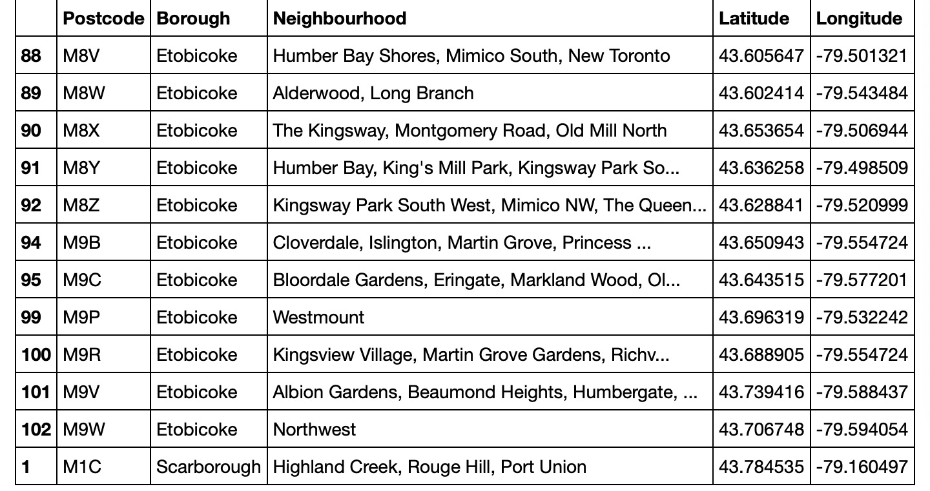
Approach
The new workplace for Tom is in Etobicoke, therefore my target are all the neighborhoods in Etobicoke

Slide 7
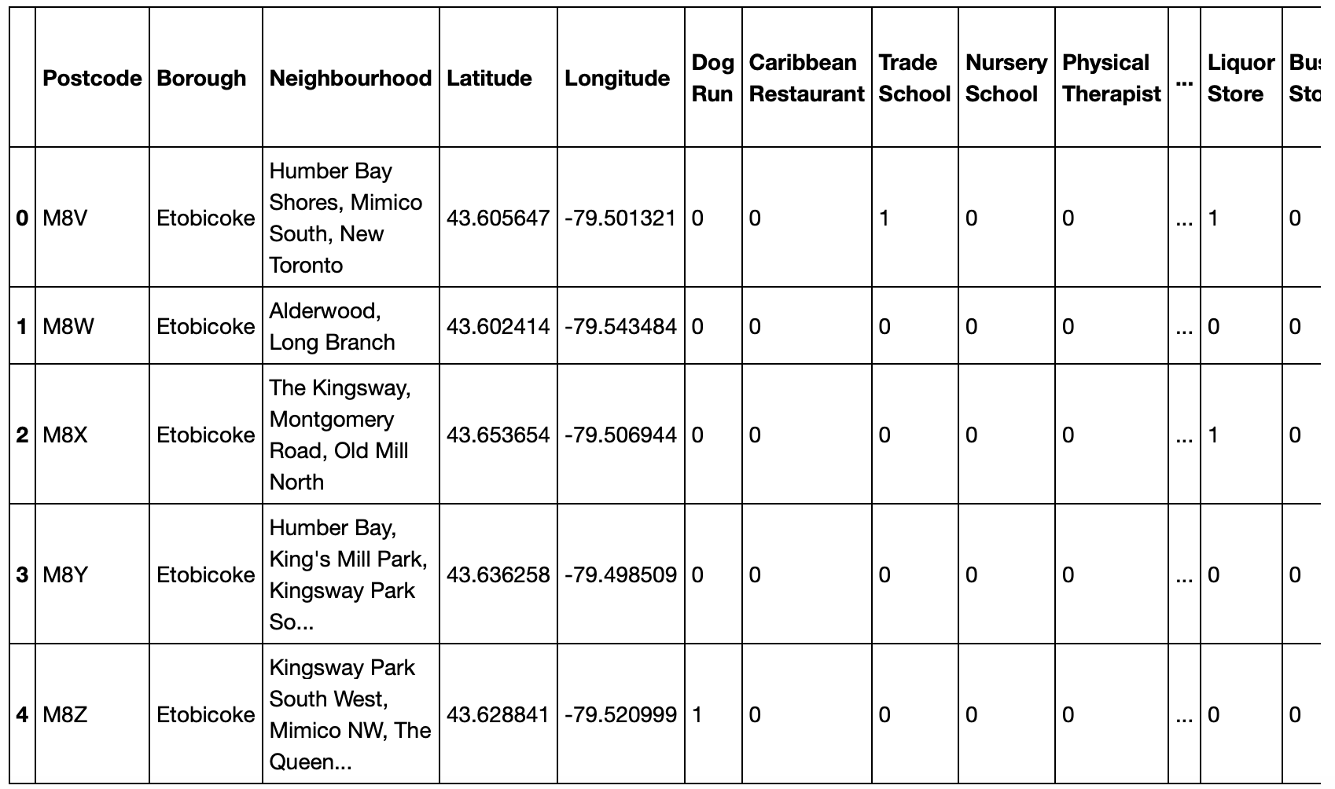
Approach
Then I collected venue categories within these areas, and convert them into dummy variables, which are 0 or 1. Don’t forget to include Highland Creek.

Slide 8
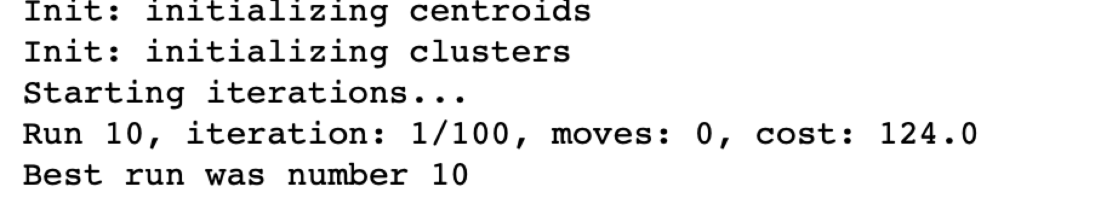
Build Model
After creating a K-modes model, I tuned the parameters by changing the number of K. The optimal K in this case is 6 which has the lowest cost.

Slide 9
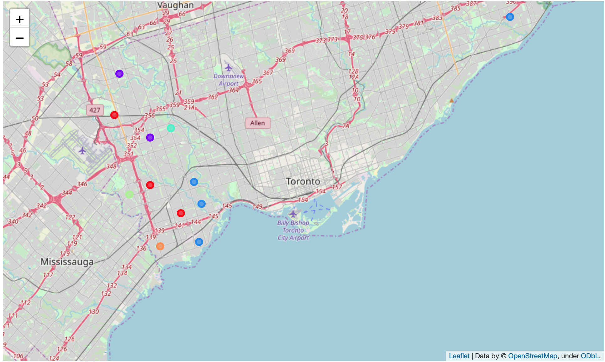
Display Clusters on Map

Slide 10
Conclusion
Therefore, I recommend Tom to move to the following neighborhoods which resemble Highland Creek that of venue categories.
Humber Bay Shores
Mimico South New Toronto
The Kingsway Montgomery Road
Old Mill North
Humber Bay
King's Mill Park
Kingsway Park South East
Mimico NE
Old Mill South
The Queensway East
Royal York South East
Sunnylea

